Slide 1

Data Analysis Presentation
by
Name

Slide 2

Introduction​
DATA ANALYSIS PRESENTATION MASTERY​
Rachelle Roller
Corp Director
Start with a brief introduction of yourself and your experience as a data analyst.
Mention the purpose of the presentation, which is to showcase your skills and explain how you can contribute to the. organisation

Slide 3

Contents​
DATA ANALYSIS PRESENTATION MASTERY​
Introduction​
Importance of Data Analysis​
Data Analysis Process​
Data Collection​
Data cleaning and Preparation​
Data Testing​
Data Analysis and Visualisations​
Examples of own work​
Qualifications/Skills​
Questions and Answers​

Slide 4







Why Data Analysis?
DATA ANALYSIS PRESENTATION MASTERY​
Place Subtitle Text Here
The ability to make a meaningful impact​
8 years experience in Data Analysis​
Facilitates data-driven decision-making​
Worked on various data Projects.​
Passion for analytics and making a difference​
Covered a wide scope of data analysis areas.​
Ample experience with data visualisation tools.​

Slide 5


Data Analysis Process​
DATA ANALYSIS PRESENTATION MASTERY​
1
2
Explain the data analysis process that you follow, including the steps you take to ensure data accuracy and completeness.​
Describe the tools and techniques you use for data analysis, such as Excel, SQL, Python, and R.​

Slide 6
Data Collection​
DATA ANALYSIS PRESENTATION MASTERY​
Explain how you collect and gather data, including any methods or tools you use to extract data from different sources.​
Describe any challenges you've faced in collecting data and how you addressed them.​

Slide 7


Data Cleaning and Preparation​
DATA ANALYSIS PRESENTATION MASTERY​
Describe how you clean and prepare data to ensure its ​
quality and accuracy.​
​
Explain any techniques you use to handle missing or ​
incomplete data.

Slide 8

Data Testing​
DATA ANALYSIS PRESENTATION MASTERY​
Ensures data accuracy​
Improves data quality​
Reduces risks​
Saves time and resources​
Improves confidence in the data​
Supports compliance
I

Slide 9



Data Analysis and Visualisation​
DATA ANALYSIS PRESENTATION MASTERY​
Insert Header Info
Insert Header Info
Explain how you analyse data to extract insights and make recommendations.​
Describe the methods you use to visualize data, such as charts, graphs, and dashboards.​
Subtitle Here
Subtitle Here
Tableau, Power BI, Excel​

Slide 10

Data Interpretation and Reporting​
DATA ANALYSIS PRESENTATION MASTERY​
Explain how you interpret data and draw conclusions ​based on your analysis.​
Describe how you report your findings to stakeholders, ​including any tools or methods you use to communicate your results​
Mention stakeholders from all over the business ​including Senior Managers.​​

Slide 11


Collaboration and Communication​
DATA ANALYSIS PRESENTATION MASTERY​
Describe your experience collaborating with others, including cross-functional teams and stakeholders.​
Explain how you communicate technical information to non-technical stakeholders.

Slide 12
Single Image & Content
DATA ANALYSIS PRESENTATION MASTERY​
Showcase some examples of your previous work, such as data analysis projects, reports, or dashboards.​
Explain the problem you were trying to solve, the data you analysed, and the insights you discovered.​

Slide 13
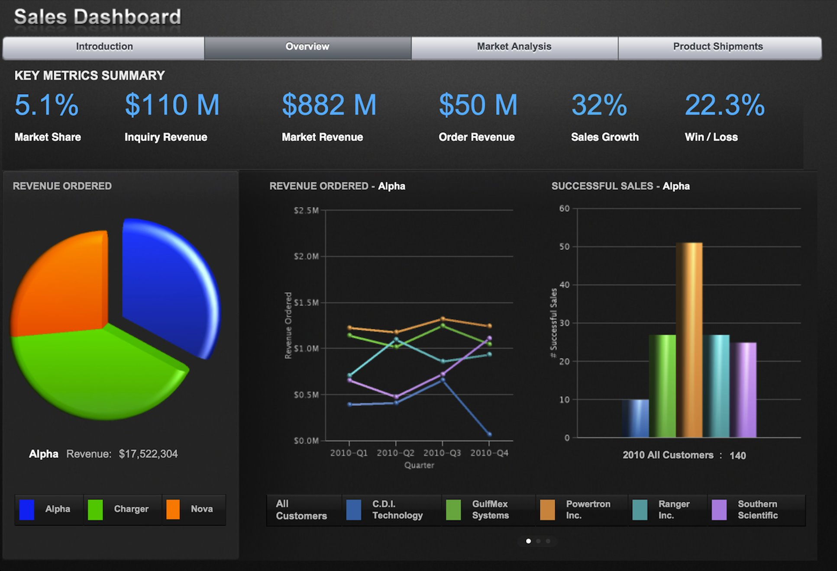
Example of Power BI Visual​

Slide 14
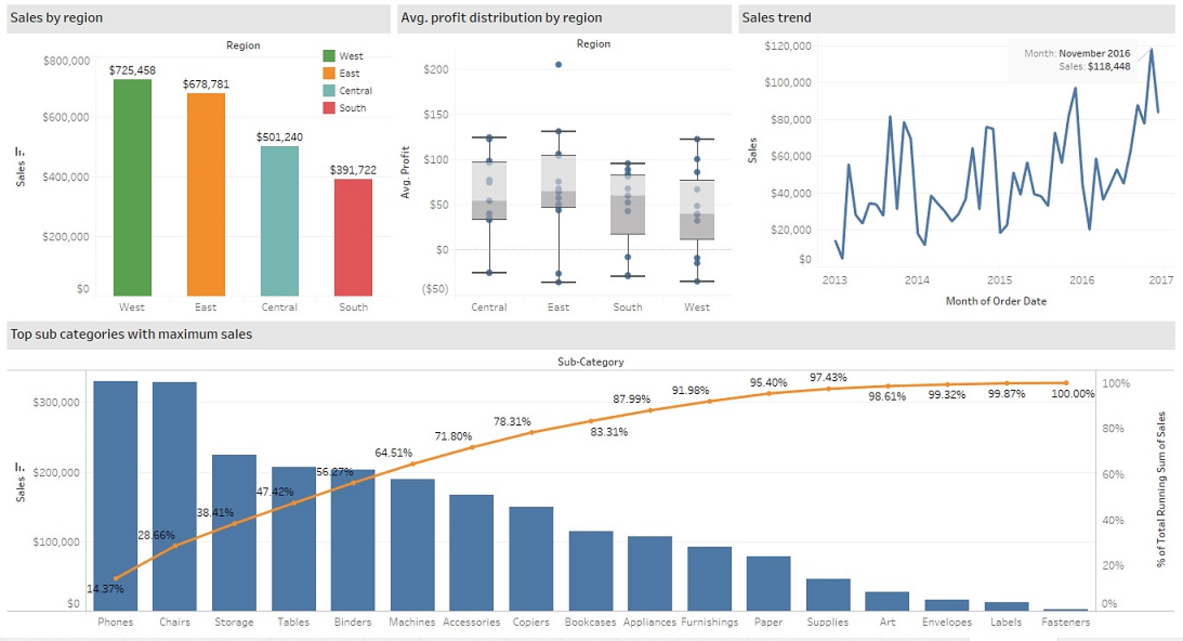
Example of Tableau BI Visual​

Slide 15
Your Qualifications and Skills​
DATA ANALYSIS PRESENTATION MASTERY​
1
Header Info Here
Summarize your qualifications and skills as a data analyst.​
2
Header Info Here
Highlight any relevant certifications or courses you've completed​
3
Header Info Here
Data camp completed Courses​

Slide 16

Why should you hire me​
DATA ANALYSIS PRESENTATION MASTERY​
Strong analytical skills​
Attention to detail​
Strong communication skills ​
Experience in data visualization​
Problem-solving skills​
Team player​
Continuous learning​
Overall - unique set of skills and experience​

Slide 17
THHANK YOU
QUESTIONS?

